Slide 1

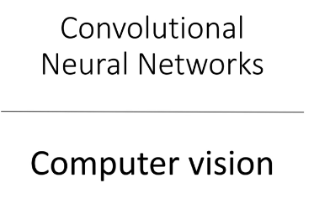
Copyright © www.ITbodhi.com

Slide 2
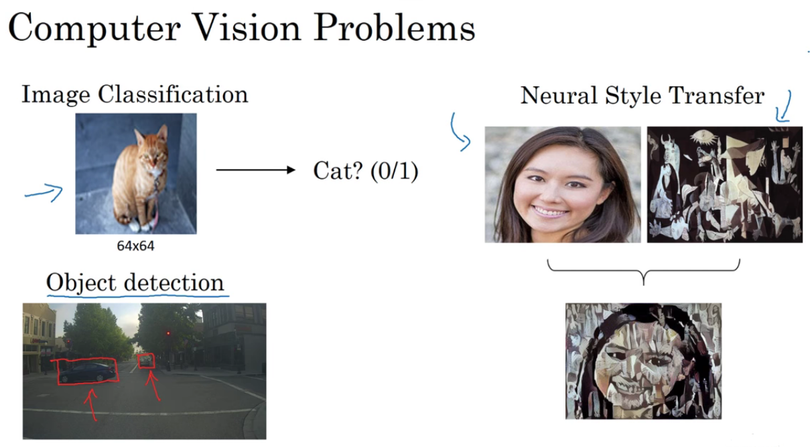
Copyright © www.ITbodhi.com

Slide 3
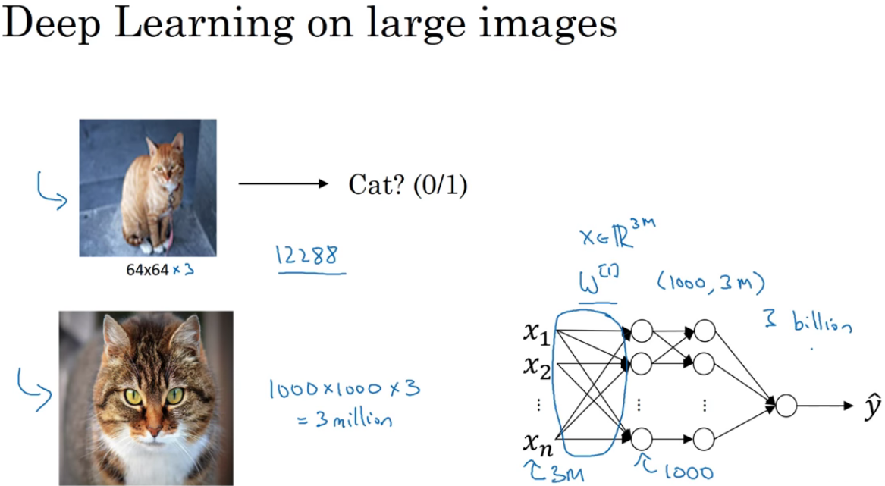
Copyright © www.ITbodhi.com

Slide 4
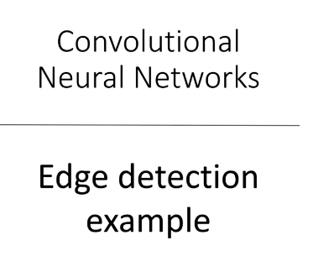
Copyright © www.ITbodhi.com

Slide 5
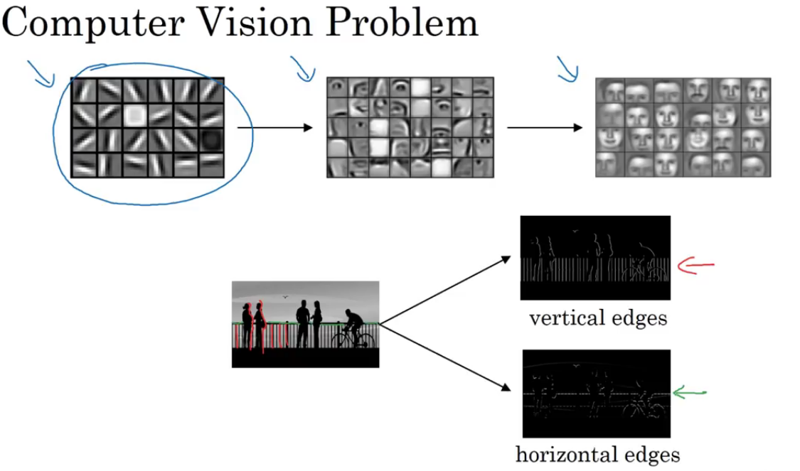
Copyright © www.ITbodhi.com

Slide 6
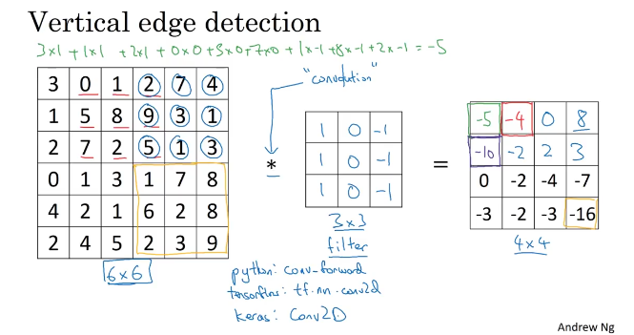
Copyright © www.ITbodhi.com

Slide 7
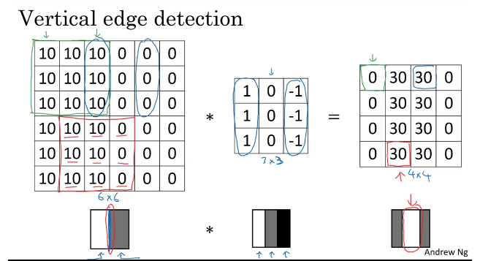
Copyright © www.ITbodhi.com

Slide 8
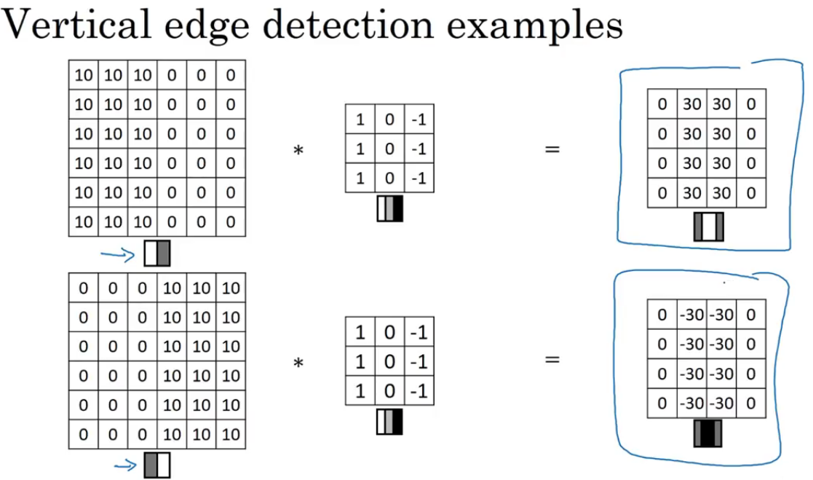
Copyright © www.ITbodhi.com

Slide 9
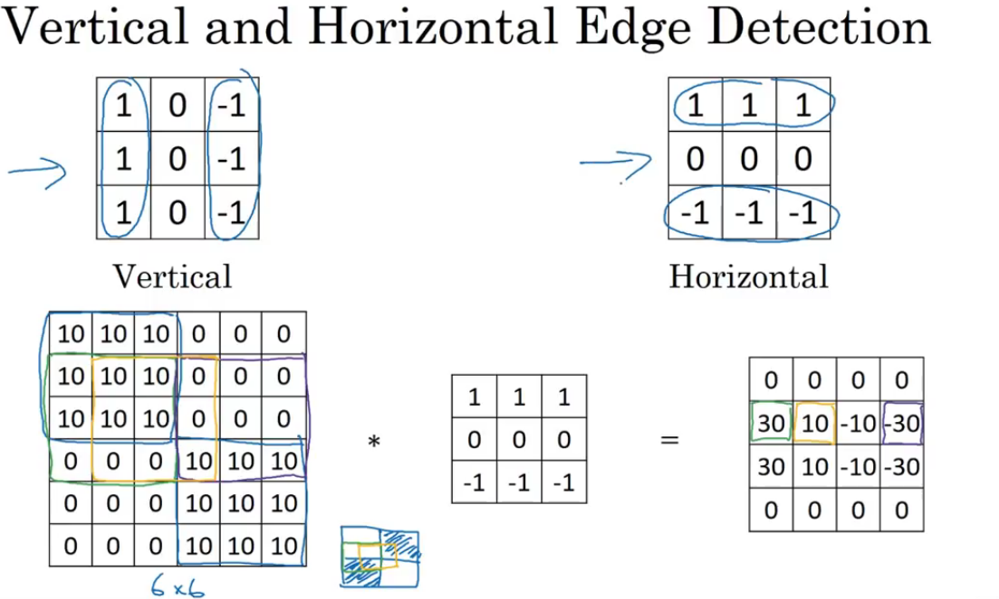
Copyright © www.ITbodhi.com

Slide 10
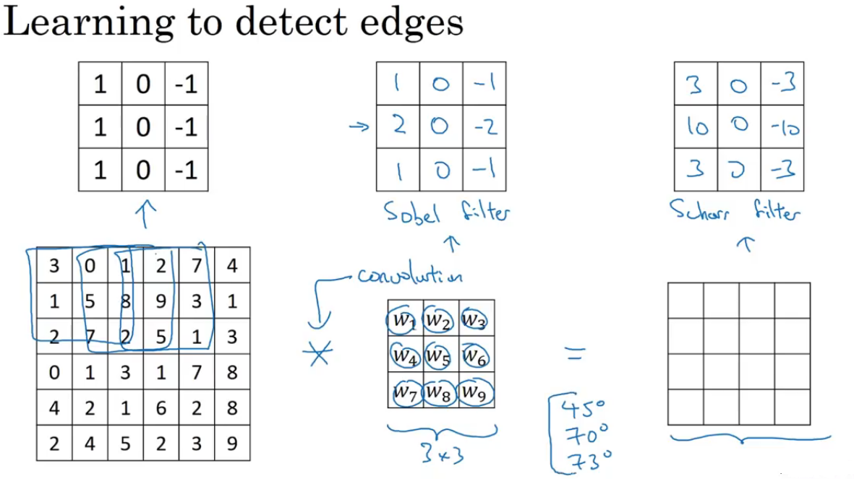
Copyright © www.ITbodhi.com

Slide 11
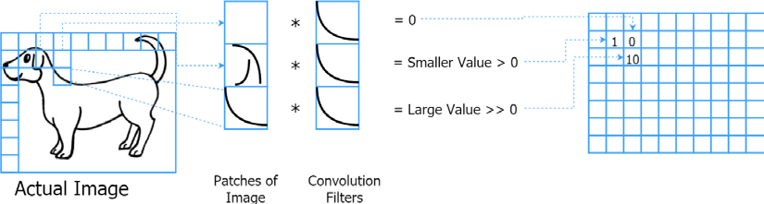
If the pattern present in a convolution filter is present in a patch of image, the convolution will output a high value for that location; if not, it will output a low value. Also, by convolving the full image, we get a matrix indicating whether a pattern was present or not in a given location. Finally, we will get a matrix as the convolution output:
Copyright © www.ITbodhi.com

Slide 12
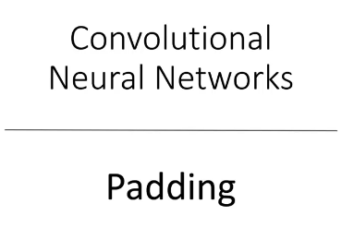
Copyright © www.ITbodhi.com

Slide 13
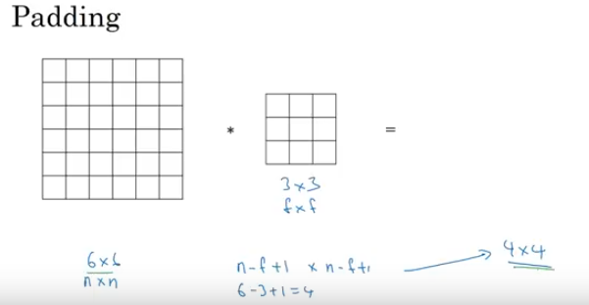
Two problems with Convolution:
Image size shrinks
Corner images does not contribute much
The inevitable output size reduction resulting from each convolution (without stride) is an undesirable property. This greatly limits the number of layers we can have in a network.
Also, it is known that deeper networks perform better than shallow networks.
Therefore, padding is used to circumvent this issue.
This is achieved by padding zeros to the boundary of the input so that the output size and the input size are equal.
Copyright © www.ITbodhi.com

Slide 14
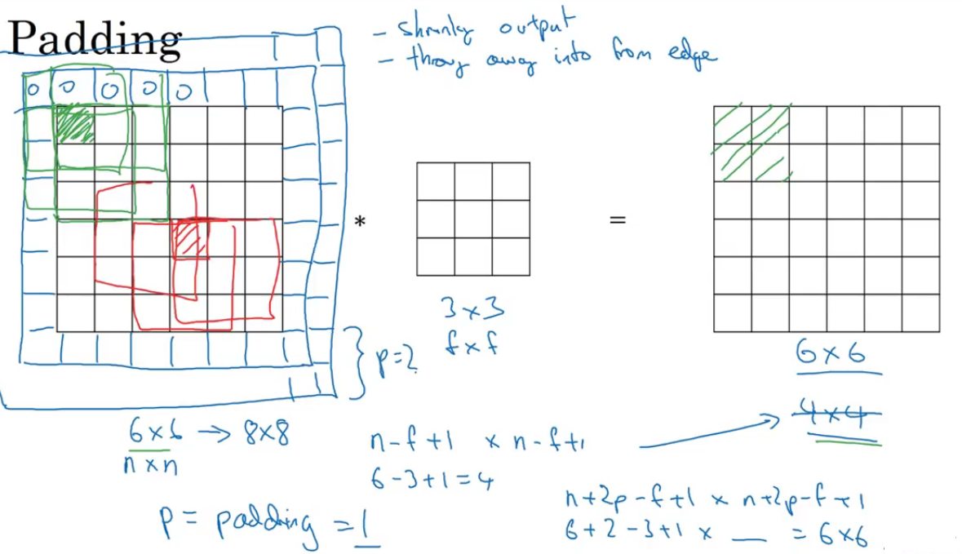
Copyright © www.ITbodhi.com

Slide 15
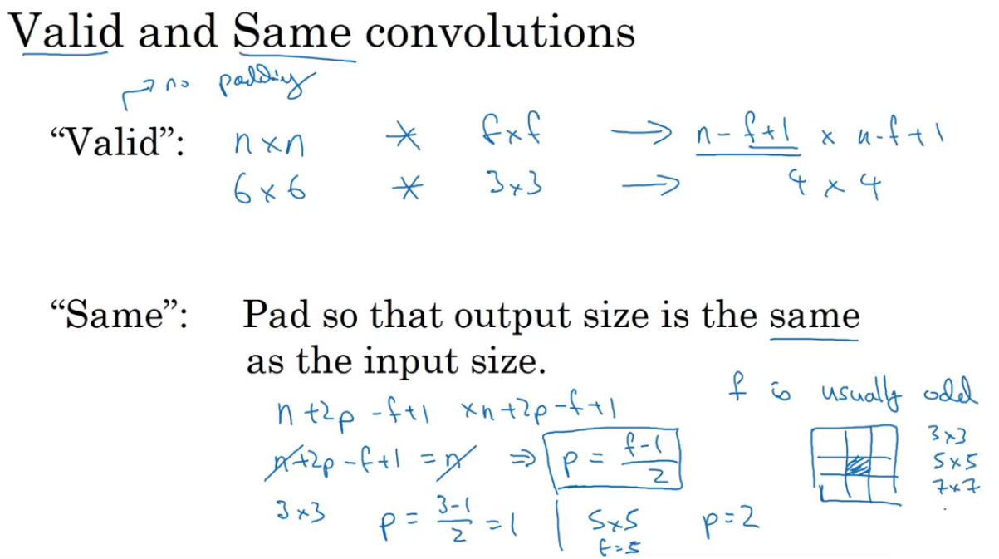
Copyright © www.ITbodhi.com

Slide 16
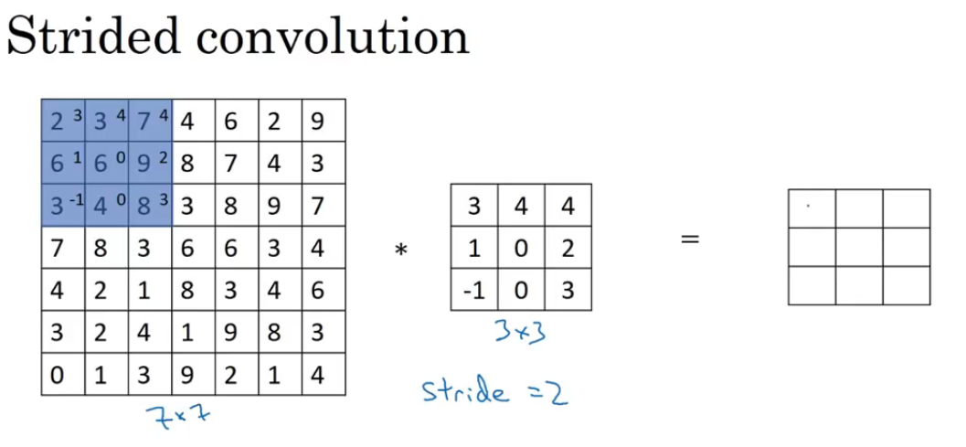
Copyright © www.ITbodhi.com

Slide 17
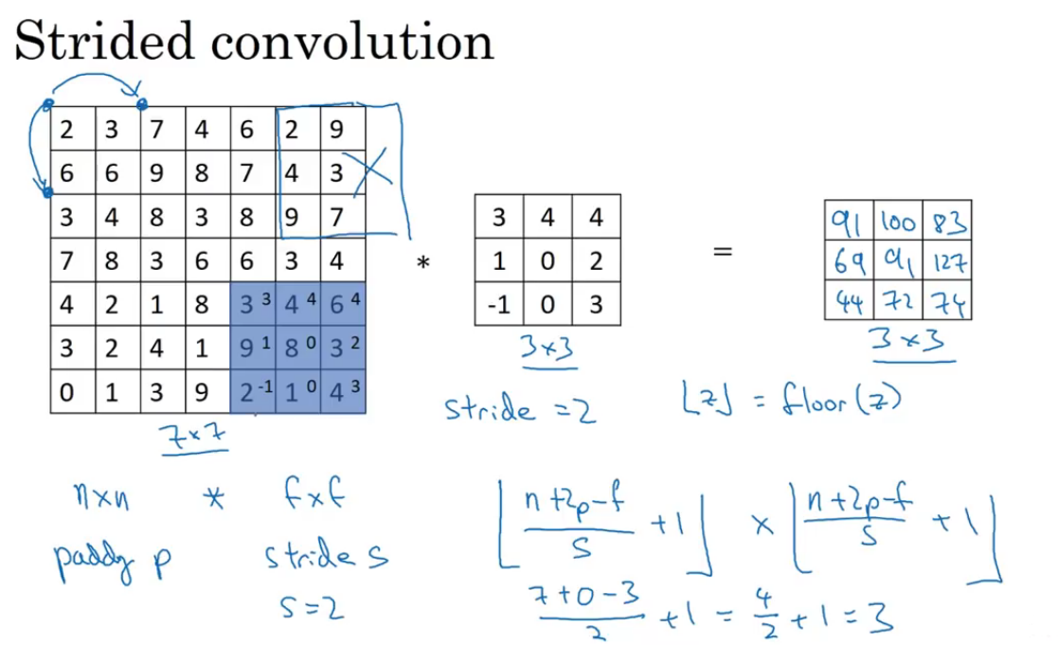
Copyright © www.ITbodhi.com

Slide 18
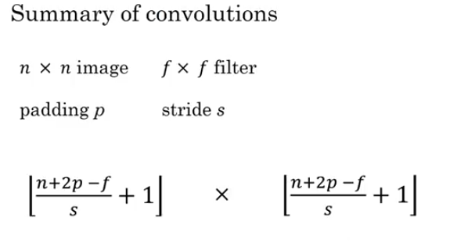
Copyright © www.ITbodhi.com

Slide 19
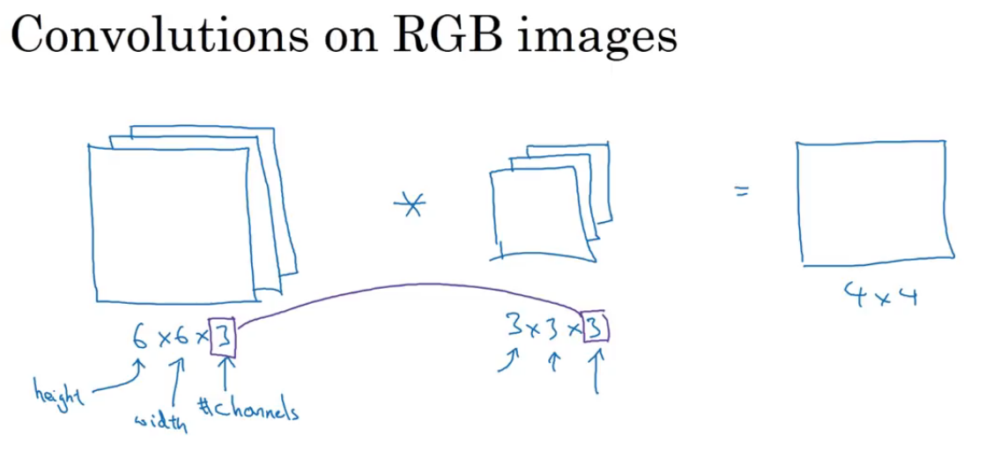
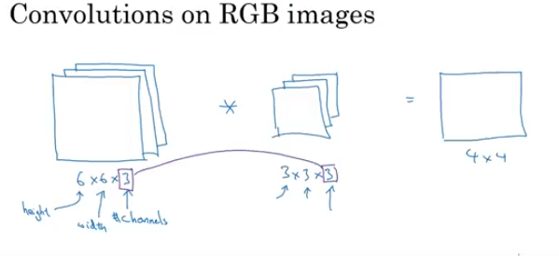
Copyright © www.ITbodhi.com

Slide 20
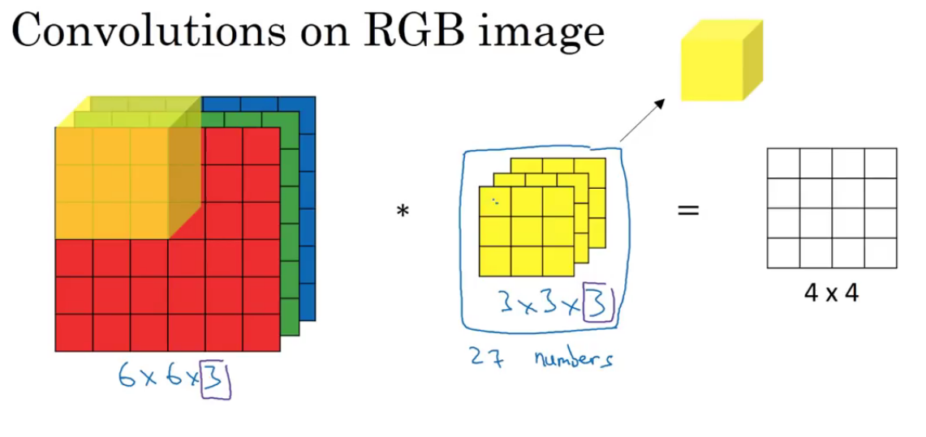
Copyright © www.ITbodhi.com

Slide 21
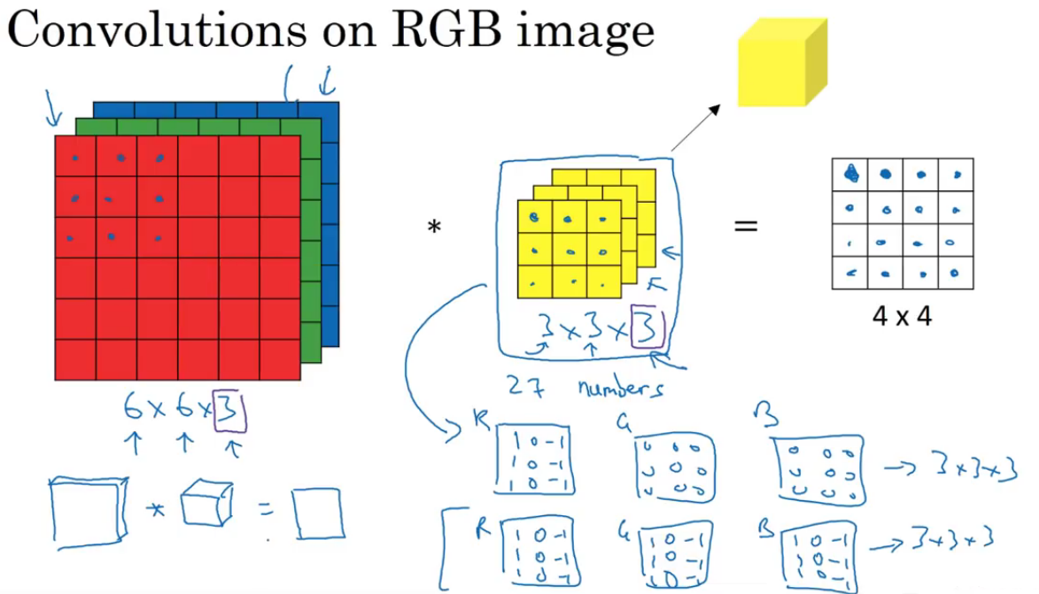
Copyright © www.ITbodhi.com

Slide 22
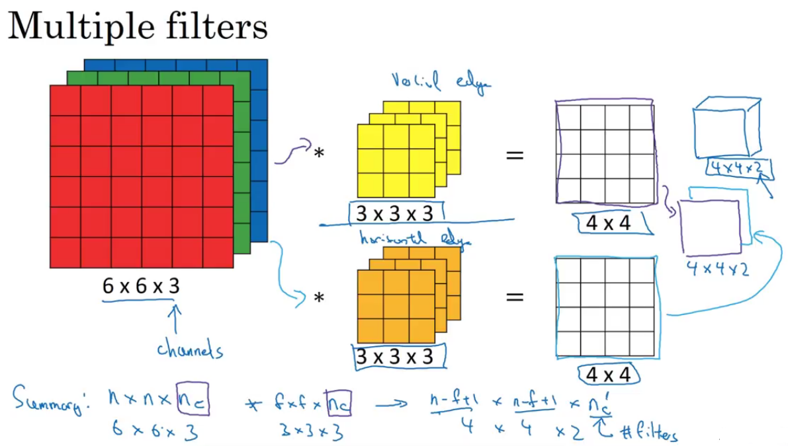
Copyright © www.ITbodhi.com

Slide 23
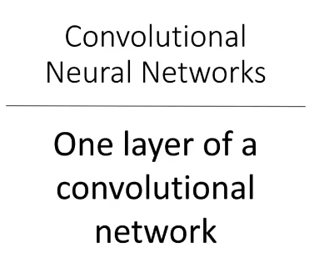
Copyright © www.ITbodhi.com

Slide 24
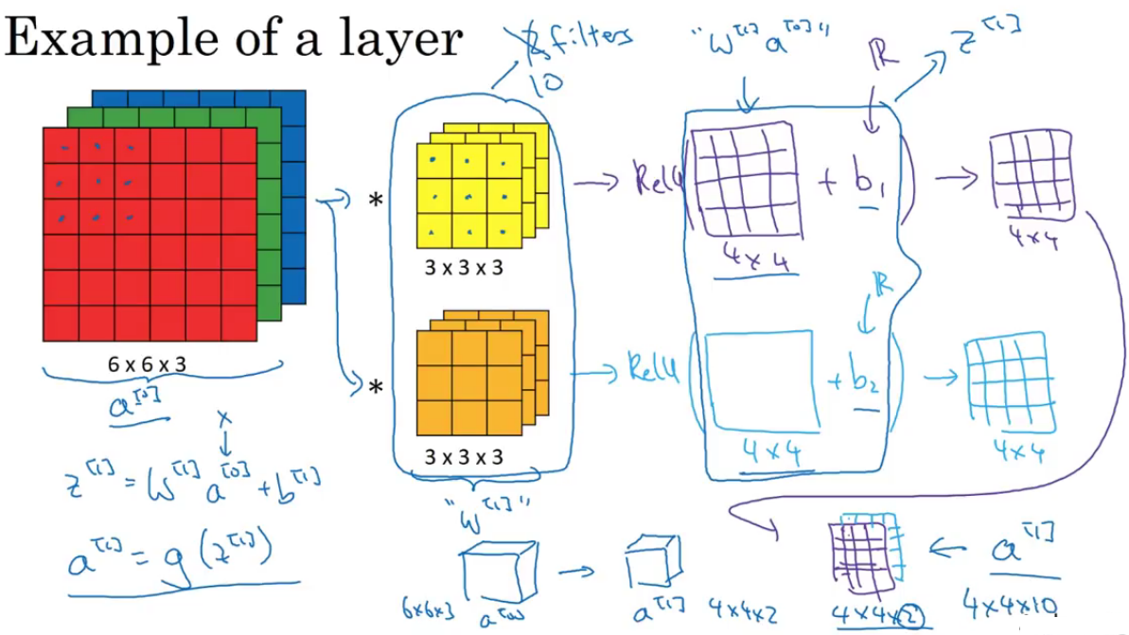
Copyright © www.ITbodhi.com

Slide 25
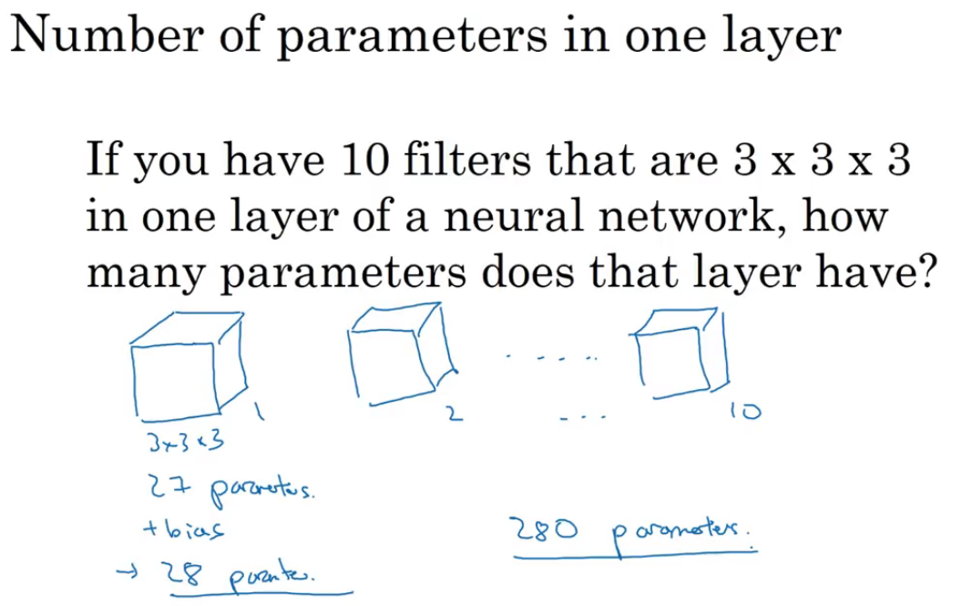
Copyright © www.ITbodhi.com

Slide 26
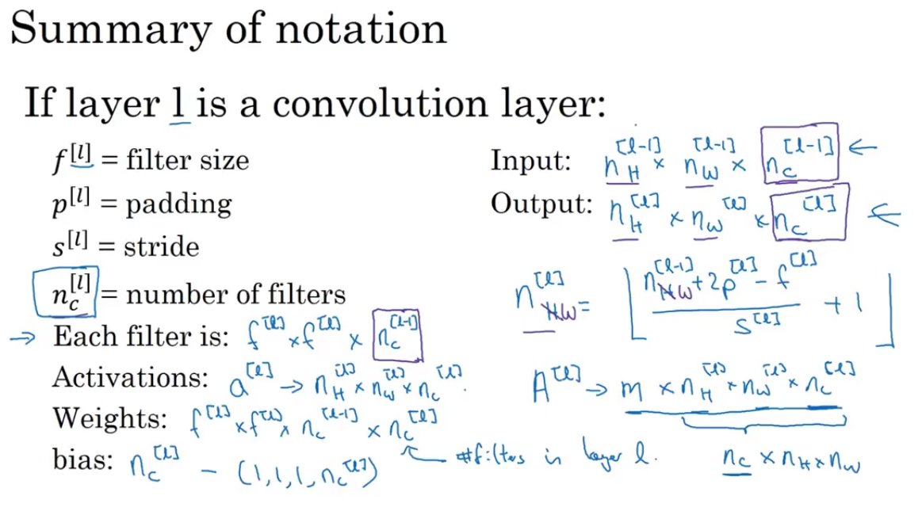
Copyright © www.ITbodhi.com

Slide 27
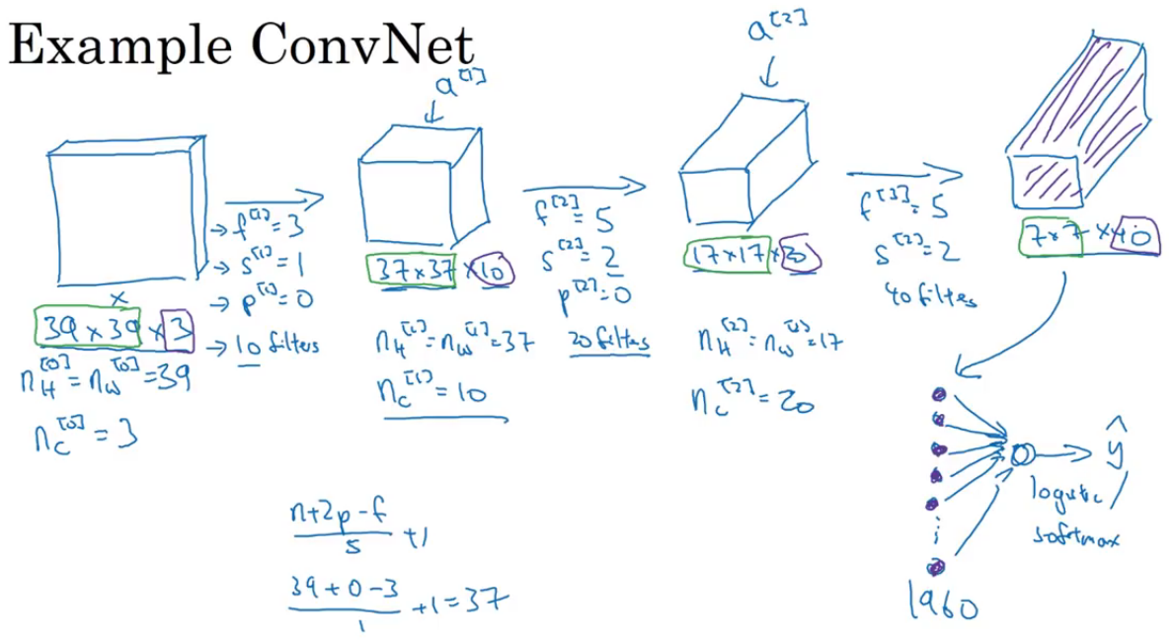
Copyright © www.ITbodhi.com
Notes:
General Trend: Image dimension decreases as go deeper in to NN towards final prediction
While number of channels increases as go deeper in to NN towards final prediction

Slide 28
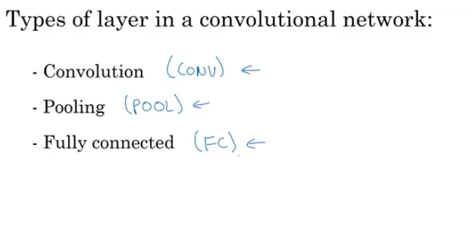
Copyright © www.ITbodhi.com
Notes:
Pooling layers added in terms of detection of features robustness and speed.

Slide 29
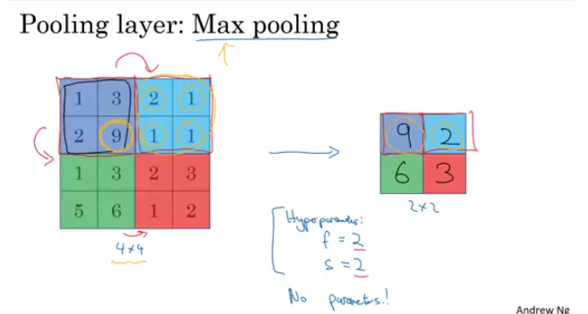
Copyright © www.ITbodhi.com
Notes:
Independent layer in output for each layer in input

Slide 30
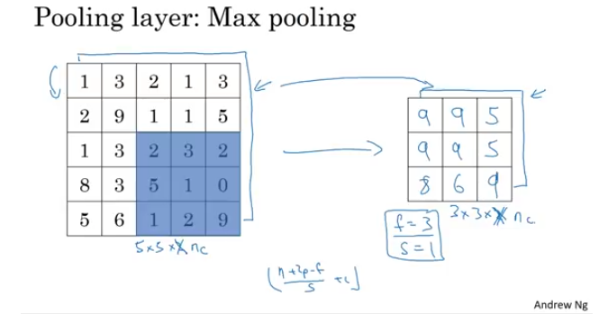
Convolution layers are optionally interleaved with pooling/subsampling layers, which reduces the dimensionality of the input.
While reducing the dimensionality, we make the translation of CNNs invariant as well as force the CNN to learn with less information, leading to better generalization and regularization of the model.
The dimensionality is reduced by dividing the input into several patches and transforming each patch to a single element.
For example, such transformations include picking the maximum element of a patch or averaging all the values in a patch.
Copyright © www.ITbodhi.com
Notes:
Independent layer in output for each layer in input.
Its function is to progressively reduce the spatial size of the representation to reduce the amount of parameters and computation in the network, and hence to also control overfitting. The Pooling Layer operates independently on every depth slice of the input and resizes it spatially, using the MAX operation

Slide 31
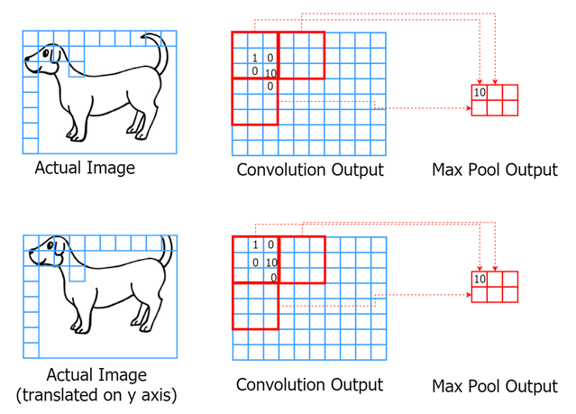
Here, we have the original image and an image slightly translated on the y axis.
We have convolution output for both images, and you can see that the value 10 appears at slightly different places in the convolution output.
However, using max pooling (which takes the maximum value of each thick square), we can get the same output at the end.
Copyright © www.ITbodhi.com
Notes:
Independent layer in output for each layer in input.

Slide 32
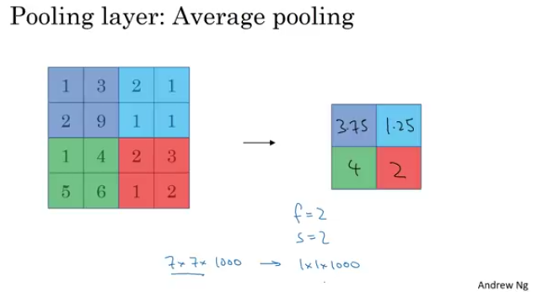
Copyright © www.ITbodhi.com
Notes:
Independent layer in output for each layer in input.
Its function is to progressively reduce the spatial size of the representation to reduce the amount of parameters and computation in the network, and hence to also control overfitting. The Pooling Layer operates independently on every depth slice of the input and resizes it spatially, using the MAX operation

Slide 33
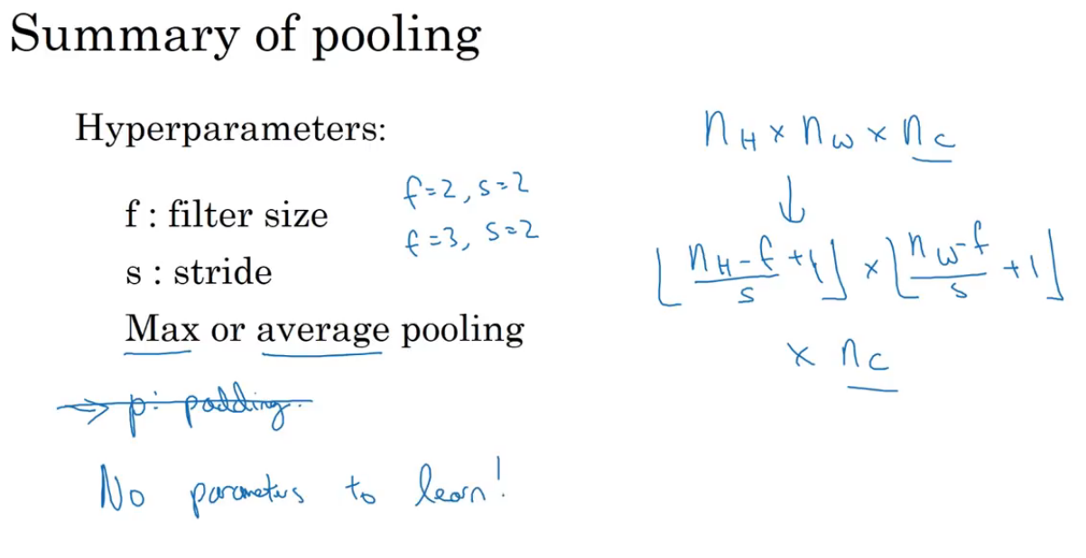
Copyright © www.ITbodhi.com
Notes:
Independent layer in output for each layer in input.

Slide 34
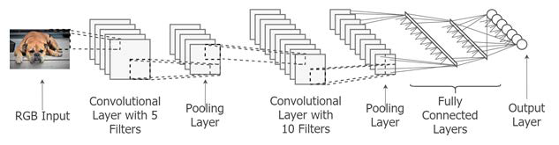
FC : Fully Connected Layer:
Finally, the output is fed to a set of fully connected layers, which then forward the output to the final classification/regression layer (for example, sentence/ image classification). Fully connected layers contain a significant fraction of the total number of weights of the CNN as convolution layers have a small number of weights.
However, it has been found that CNNs perform better with fully connected layers than without them.
This could be because convolution layers learn more localized features due to small size, whereas fully connected layers provide a global picture about how these localized features should be connected together to produce a desirable final output.
Copyright © www.ITbodhi.com

Slide 35
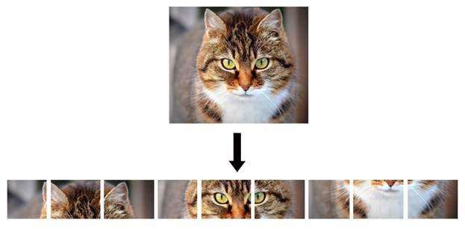
CNNs, by design, preserve the spatial structure of the inputs during the learning.
In other words, for a two-dimensional input, a CNN will have most of the layers two-dimensional, whereas we have fully connected layers only close to the output layer.
Preserving the spatial structure allows CNNs to exploit valuable spatial information of the inputs and learn about inputs with fewer parameters.
As you can see, when a two-dimensional image of a cat is unwrapped to be a one-dimensional vector, ears are no longer close to the eyes, and the nose is far away from the eyes as well. This means we have destroyed some of useful spatial information during the unwrapping.
Copyright © www.ITbodhi.com

Slide 36
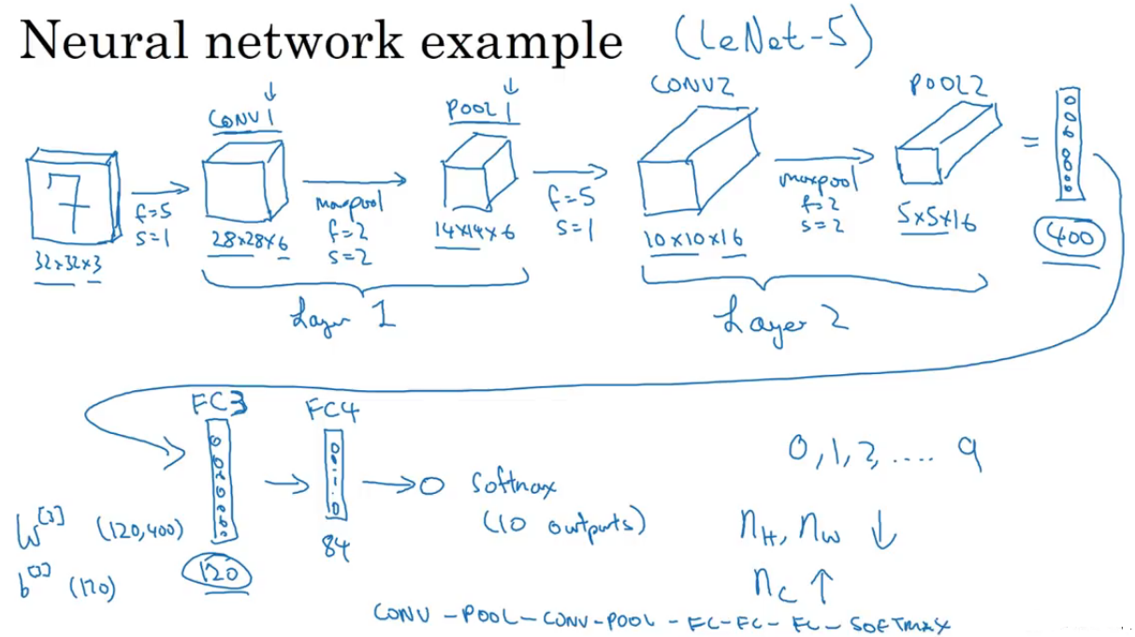
Copyright © www.ITbodhi.com
Notes:
Independent layer in output for each layer in input.

Slide 37
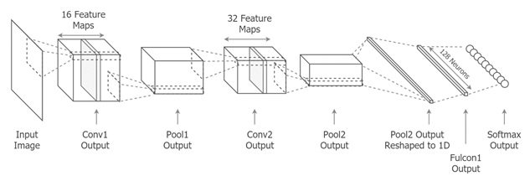
The lower convolution layers learn low-level features such as differently oriented edges present in the images, and the higher layers learn more high-level features such as shapes present in the images (for example, circles and triangles) or bigger parts of an object (for example, the face of a dog, tail of a dog, and front section of a car).
The pooling layers in the middle make each of these learned features slightly translation invariant. This means that in a new image even if the feature appears a bit offset compared to the location in which the feature appeared in the learned images, the CNN will still recognize that feature.
Finally, the fully connected layers combine the high-level features learned by the CNN to produce global representations that will be used by the final output layer to determine the class the object belongs to.
Copyright © www.ITbodhi.com
Notes:
Independent layer in output for each layer in input.

Slide 38
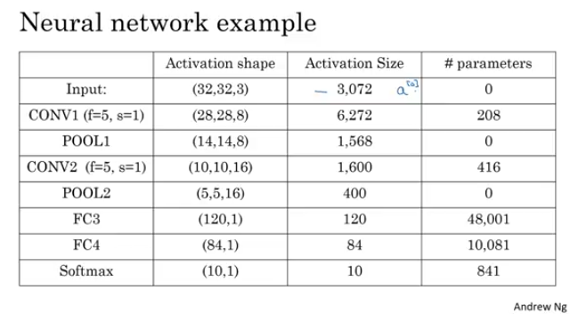
8 Filters
----------
8 filters
-----------
16 filters
-----------
16 filters
Copyright © www.ITbodhi.com
Notes:
Independent layer in output for each layer in input.

Slide 39
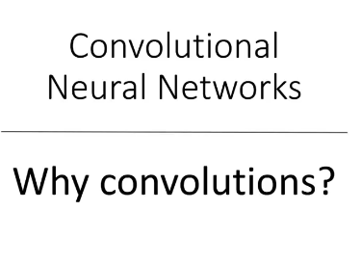
Copyright © www.ITbodhi.com
Notes:
Independent layer in output for each layer in input.

Slide 40
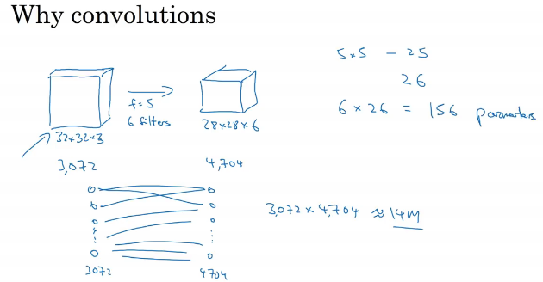
Number weight calculated are very less than compare to a Feed Forward NN
Copyright © www.ITbodhi.com

Slide 41
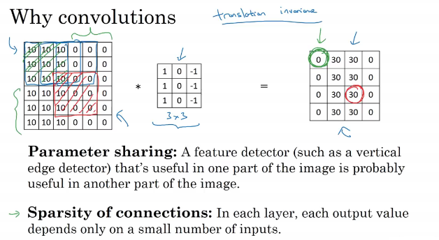
Copyright © www.ITbodhi.com
Notes:
Independent layer in output for each layer in input.

Slide 42
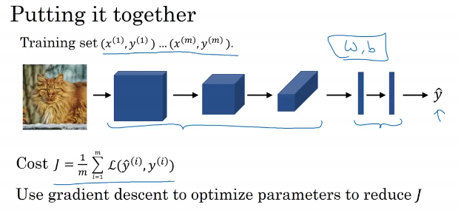
Copyright © www.ITbodhi.com
Notes:
Independent layer in output for each layer in input.

Slide 43
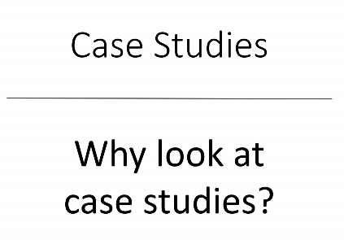
Copyright © www.ITbodhi.com
Notes:
Independent layer in output for each layer in input.

Slide 44
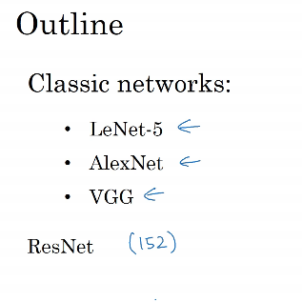
Copyright © www.ITbodhi.com
Notes:
Independent layer in output for each layer in input.

Slide 45
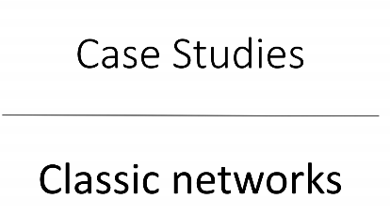
Copyright © www.ITbodhi.com
Notes:
Independent layer in output for each layer in input.

Slide 46
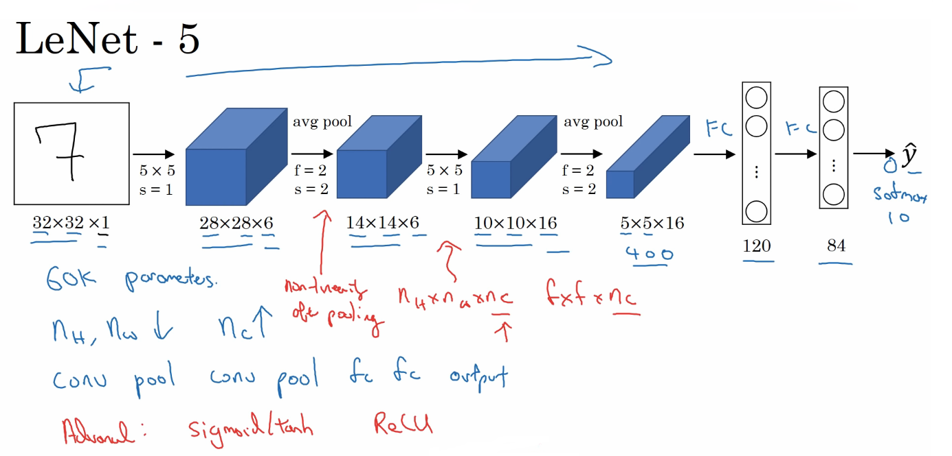
Copyright © www.ITbodhi.com
Notes:
Independent layer in output for each layer in input.

Slide 47
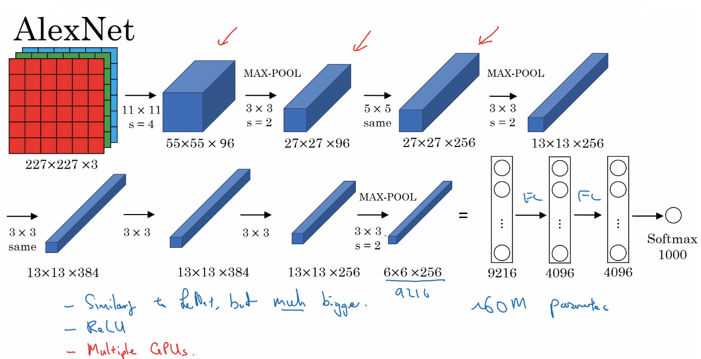
Copyright © www.ITbodhi.com
Notes:
AlexNet famously won the 2012 ImageNet LSVRC-2012 competition by a large margin (15.3% VS 26.2% (second place) error rates).
AlexNet is the name of a convolutional neural network, designed by Alex Krizhevsky, and published with Ilya Sutskever and Krizhevsky's PhD advisor Geoffrey Hinton

Slide 48
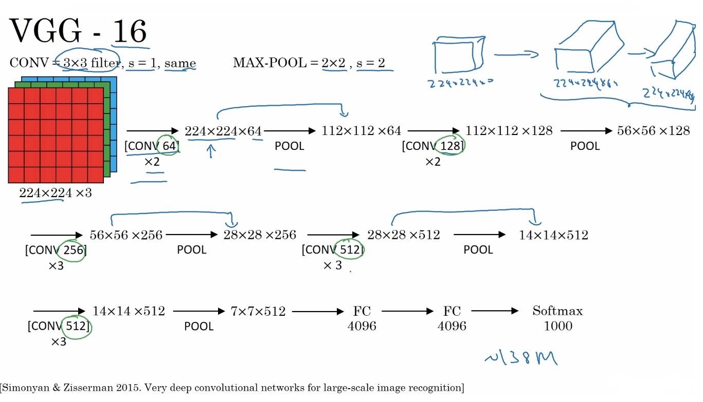
Copyright © www.ITbodhi.com

Slide 49
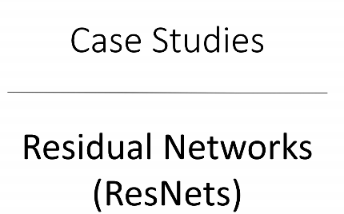
Very Deep network are hard to train because of Gradient vanishing and Gradient Explode problem.
Resnet allow to train very deep network
Copyright © www.ITbodhi.com
Notes:
FROM Microsoft research

Slide 50

Copyright © www.ITbodhi.com
Notes:
Work very much better in case very deep network and remove the problem of vanishing or exploding gradient decent

Slide 51

Copyright © www.ITbodhi.com
Notes:
Work very much better in case very deep network and remove the problem of vanishing or exploding gradient decent

Slide 52

Copyright © www.ITbodhi.com
Notes:
Work very much better in case very deep network and remove the problem of vanishing or exploding gradient decent

Slide 53

Parameter shrinks due to regularization so this complete residual unit work as a identity unit.
To make addition easy for a(l) and a(l+2) ,same convolutions are used.
Copyright © www.ITbodhi.com
Notes:
Parameter shrinks due to regularization so this complete residual unit work as a identity unit.
To make addition easy for a(l) and a(l+2) ,same convolutions are used.

Slide 54

Copyright © www.ITbodhi.com
Notes:
Parameter shrinks due to regularization so this complete residual unit work as a identity unit.
To make addition easy for a(l) and a(l+2) ,same convolutions are used.

Slide 55

Copyright © www.ITbodhi.com
Notes:
Parameter shrinks due to regularization so this complete residual unit work as a identity unit.
To make addition easy for a(l) and a(l+2) ,same convolutions are used.

Slide 56

It works like a fully connected layer of the NN
Also called Network in network.
Pooling layers are used to shrink width and height of the input but 1X1 convolution is used to shrink number of channels
Copyright © www.ITbodhi.com
Notes:
Used to shrink number of channels

Slide 57

To shrink and augment the number of channels
If number of channels are equal to the depth of input then 1X1 convolution can be used to Just to add non linearity ( Activation function will be applied) to learn more complex functions
Copyright © www.ITbodhi.com

Slide 58

Gives flexibility to use multiple kind of convolutions, pooling in a single layer
More Robust in learning
More Complex
Copyright © www.ITbodhi.com
Notes:
Just To add non linearity

Slide 59

Copyright © www.ITbodhi.com
Notes:
Problem is computational cost

Slide 60

Copyright © www.ITbodhi.com

Slide 61

Here you can see computational cost decreased by 10 times using 1X1 convolution layer that can be used in Inception network to reduce the cost significantly.
1X1 convolutional layer also called bottleneck because it is shrinking the size to blow it again in next layer.
Copyright © www.ITbodhi.com

Slide 62

Copyright © www.ITbodhi.com
Notes:
Just To add non linearity

Slide 63

Developed at Google.
Also called GoogleNet
Copyright © www.ITbodhi.com

Slide 64

Copyright © www.ITbodhi.com
Notes:
Just To add non linearity

Slide 65

We need to provide more and more data to CNN for better results.
If we have limited or small input data set and how can we overcome this challenge?
Copyright © www.ITbodhi.com
Notes:
Just To add non linearity

Slide 66

We need to provide more and more data to CNN for better results.
If we have limited or small input data set and how can we overcome this challenge?
Copyright © www.ITbodhi.com
Notes:
Just To add non linearity

Slide 67

PCA Color augmentation technique can be used for color shifting
Copyright © www.ITbodhi.com
Notes:
Just To add non linearity

Slide 68

Not recommended in actual production system deployment because it will require more resources and also time complexity would be very high.
Copyright © www.ITbodhi.com

Slide 69

Copyright © www.ITbodhi.com

Slide 70

Copyright © www.ITbodhi.com

Slide 71

In case of Image classification there is one single large object in the image that has to be identified and in case of localization , location of the object has also to identified in the image and a box has to be drawn around it.
In case of object detection there are multiple objects in a image and each object has to be identified i.e. in case of autonomous driving.
Copyright © www.ITbodhi.com

Slide 72

(bx,by) = mid point of the object
bh= height of the object
Bw= width of the object
Copyright © www.ITbodhi.com

Slide 73

Pc = Probability if image has any object in the o/p class given ( Pedestrian, Car, Motorcycle)
Bx, By,Bh,Bw = Object dimensions if Pc=1
C1,C2,C3 = Probabilities of different o/p class if Pc=1
Copyright © www.ITbodhi.com

Slide 74

Copyright © www.ITbodhi.com

Slide 75


In Landmark detection CNN detect the different important landmark in a given object in image
Example: Face recognition landmark could be eye, forehead, jaw, Cheeks, Lips coordinates etc.
These landmark could be used to identify the face emotions (happy , sad etc.) or can be used to apply several effect to the face. i.e putting hat or crown or apply emotions effect etc.
Copyright © www.ITbodhi.com

Slide 76

Copyright © www.ITbodhi.com

Slide 77

Train a CNN that classify the images which has accurately have only single object.
Copyright © www.ITbodhi.com

Slide 78

If window is large then object detection would not be accurate.
If window size is relatively small them computation cost would be very high because all these window has to pass to the CNN for image classification..
Copyright © www.ITbodhi.com

Slide 79

Copyright © www.ITbodhi.com

Slide 80

Copyright © www.ITbodhi.com

Slide 81

Now each cell in final output represents the output if single image with of window size had been passed to the CNN.
Computations are shared in contrast if all the window are passed separately to the CNN
Maxpool 2 corresponds to the stride equal to 2 on the original image.
Copyright © www.ITbodhi.com

Slide 82

Now image of size 28X28 is passed to the CNN with that originally work on the 14X14 image size for image classification and each cell of o/p corresponds to the 14X14 size input classification o/p
Copyright © www.ITbodhi.com

Slide 83

To determine accurate box boundaries.
Copyright © www.ITbodhi.com

Slide 84

Sliding window does not give the box exactly capture the object in the image
Copyright © www.ITbodhi.com

Slide 85

Divide image in to grids i.e. 3X3 or 19X19
Even if the objects is distributed among multiple grids we care about mid point of the image in which grid it is located.
Algorithm works pretty good as far as single object lie in a single grid. Increasing the grid size reduce the chances of having more than one object in a single grid.
Copyright © www.ITbodhi.com

Slide 86

All o/p values are relative to grid size
Copyright © www.ITbodhi.com

Slide 87

Evaluating the performance of the image detection model
Copyright © www.ITbodhi.com

Slide 88

Higher the IOU better is the accuracy of localization
Perfect case IOU=1
0.5 is just any the threshold that you have decided it could be .6 ,.7 or so
Copyright © www.ITbodhi.com

Slide 89

Optimization of YOLO
Rectify the problem that single object is detected multiple times in a image.
Copyright © www.ITbodhi.com

Slide 90

Ideally center point of the image should lie in any of the grid.
But practically it is found that near by grids mistakenly calculate center point of the objects lie in it..
Copyright © www.ITbodhi.com

Slide 91


Step1: Find out the rectangles with highest probability Pc for a object
Step2: Suppress all the rectangles which have higher IOU
Step3: Repeat sate1-2 for all other object rectangles.
Copyright © www.ITbodhi.com

Slide 92

Lets say we have only one class of object to identify i.e. CAR
Copyright © www.ITbodhi.com

Slide 93

When more than one object lie in a single GRID
Optimization of YOLO
Copyright © www.ITbodhi.com

Slide 94

Different Anchor boxes for different objects
Each object is compared with Anchor boxes to identify which objects lie in the GRID
If both the objects lie in the GRID then o/p would be multiple of object dimension as above.
Copyright © www.ITbodhi.com

Slide 95

Anchor box sizes can be selected manually
In advance version of YOLO Kmeans Algorithm is used to select different sizes of Anchor boxes..
Copyright © www.ITbodhi.com

Slide 96

Copyright © www.ITbodhi.com

Slide 97

Copyright © www.ITbodhi.com

Slide 98

Copyright © www.ITbodhi.com

Slide 99


Slide 100

Notes:
DarkNet already trained YOLO on COCO data set

Slide 101


Slide 102

You have only single image of the person
Building a RNN with softmax function with only single image per class would not train great RNN.
Again if new person joins then softmax function has to be changed and RNN need to be train again.
Copyright © www.ITbodhi.com

Slide 103

Now we will try to find out similarity between two images.
If difference is greater than some value lambda then they are different person other wise same
Lambda is hyperparameter.
Copyright © www.ITbodhi.com

Slide 104

Training NN to learn the similarity function.
Copyright © www.ITbodhi.com

Slide 105

Both the Images are being input to a identical CNN with last softmax layer removed.
Last NN layer’s neurons makes a vector of values. That is the encoding of image x and layer is encoding function f(x)
To compare two images , both are passed to same CNN and distance between both the encoding vectors is calculated. That is generally L2 NORM
This type of Network is called Siamese network architecture. How to train Siamese Network?
Copyright © www.ITbodhi.com

Slide 106

Siamese CNN is trained through back propagation and weights are learned to make sure the distance between similar image is small.
And distance between different images are large.
What would be the Cost Function ??
Copyright © www.ITbodhi.com

Slide 107

Siamese CNN is trained through back propagation and weights are learned to make sure the distance between similar image is small.
And distance between different images are large.
What would be the Cost Function ??
Copyright © www.ITbodhi.com

Slide 108

For training the model we take 3 samples one as Anchor image , second similar Positive image and third Non similar Negative image.
Now objective of learning CNN is to have distance (Anchor, Positive) <= distance (Anchor, Negative)
Copyright © www.ITbodhi.com

Slide 109

In a special case above condition ( = ) equal to satisfied when all the f(A),f(P) and f(N) are zero. That you do not want because in this case all vector values for all the images would be zero always.
To avoid this situation a Margin Alpha is added to the learning objective equation.
And if alpha=.2 the it make sure that there should always be distance of .2 between Positive and Negative case.
Copyright © www.ITbodhi.com

Slide 110

This is called Triplet Loss Function because three images are being used to calculate the loss.
Make triplet out of training images to train the CNN
How to choose these triple set??
Copyright © www.ITbodhi.com

Slide 111

For training choose triplets which are hard to train on like similar and dissimilar images are hard to idenify .
In this case to satisfy the loss function condition NN would be trained better to find out the different images.
HAPPY NEWS: Many of the companies have already trained Face Recognition CNN on very large data set and are publicly available with trained weights so you can directly use the same instead of building your own.
Copyright © www.ITbodhi.com

Slide 112

Variant of Siamese Network
Copyright © www.ITbodhi.com

Slide 113

Copyright © www.ITbodhi.com

Slide 114

Copyright © www.ITbodhi.com

Slide 115

ECG data given on time series and values presents voltage on different time
This is a one dimensional data
RNN is used for one dimensional data but you can also use CNN for the same.
Copyright © www.ITbodhi.com
Notes:
ECG data given on time series and values presents voltage on different time
This is a one dimensional data
RNN is used for one dimensional data but you can also use CNN for the same.

Slide 116

3 D data like MRI that gives image of slices of brain or torso etc.
Movie frames with time
Copyright © www.ITbodhi.com
Notes:
ECG data given on time series and values presents voltage on different time
This is a one dimensional data
RNN is used for one dimensional data but you can also use CNN for the same.

Slide 117

Copyright © www.ITbodhi.com
Notes:
Just To add non linearity

